Slide 1
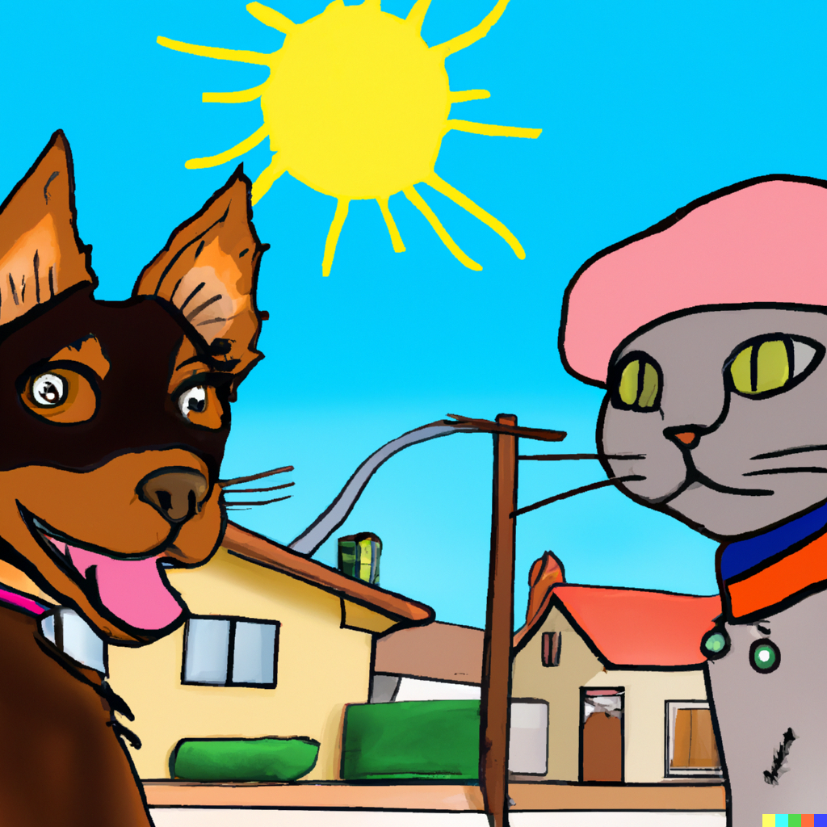
Once upon a sunny day, in a cozy little town, there lived a dog named Benny and a cat named Bella.

Slide 2
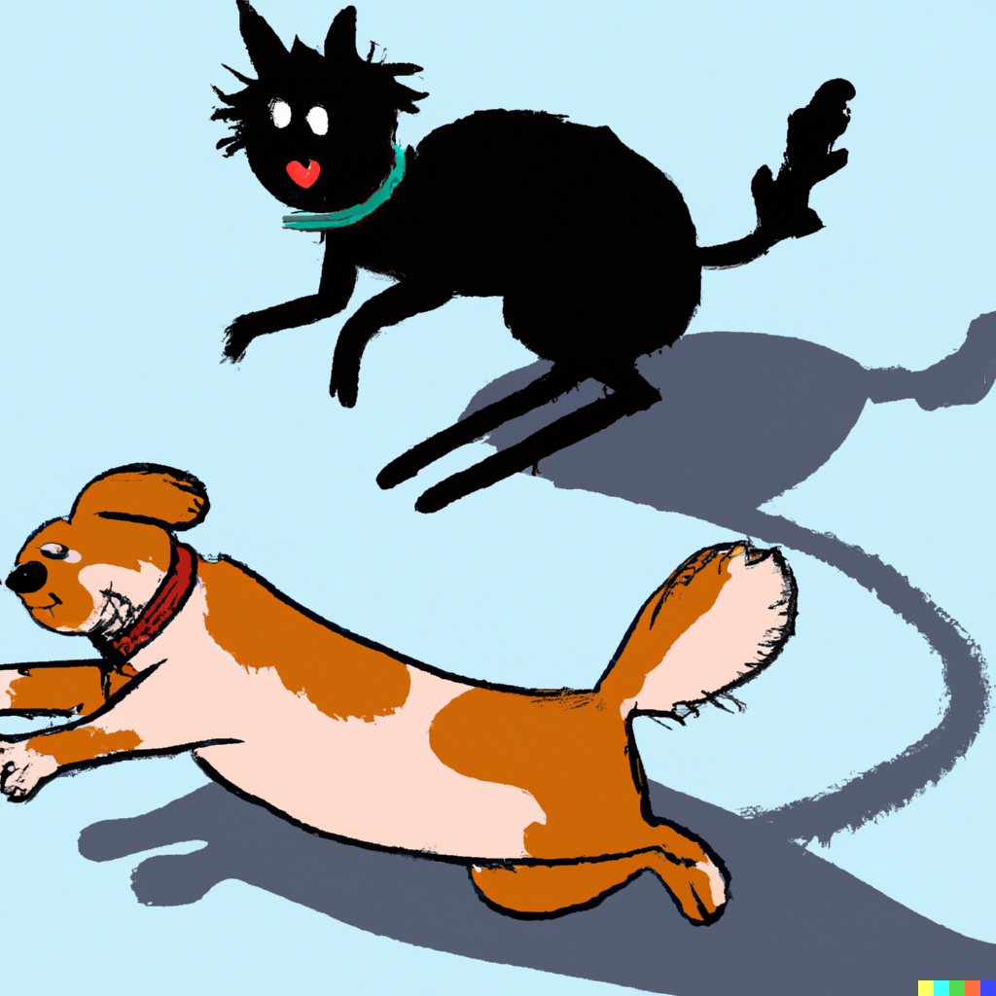
Benny loved to run and chase his tail, while Bella preferred to hide and pounce on shadows.

Slide 3
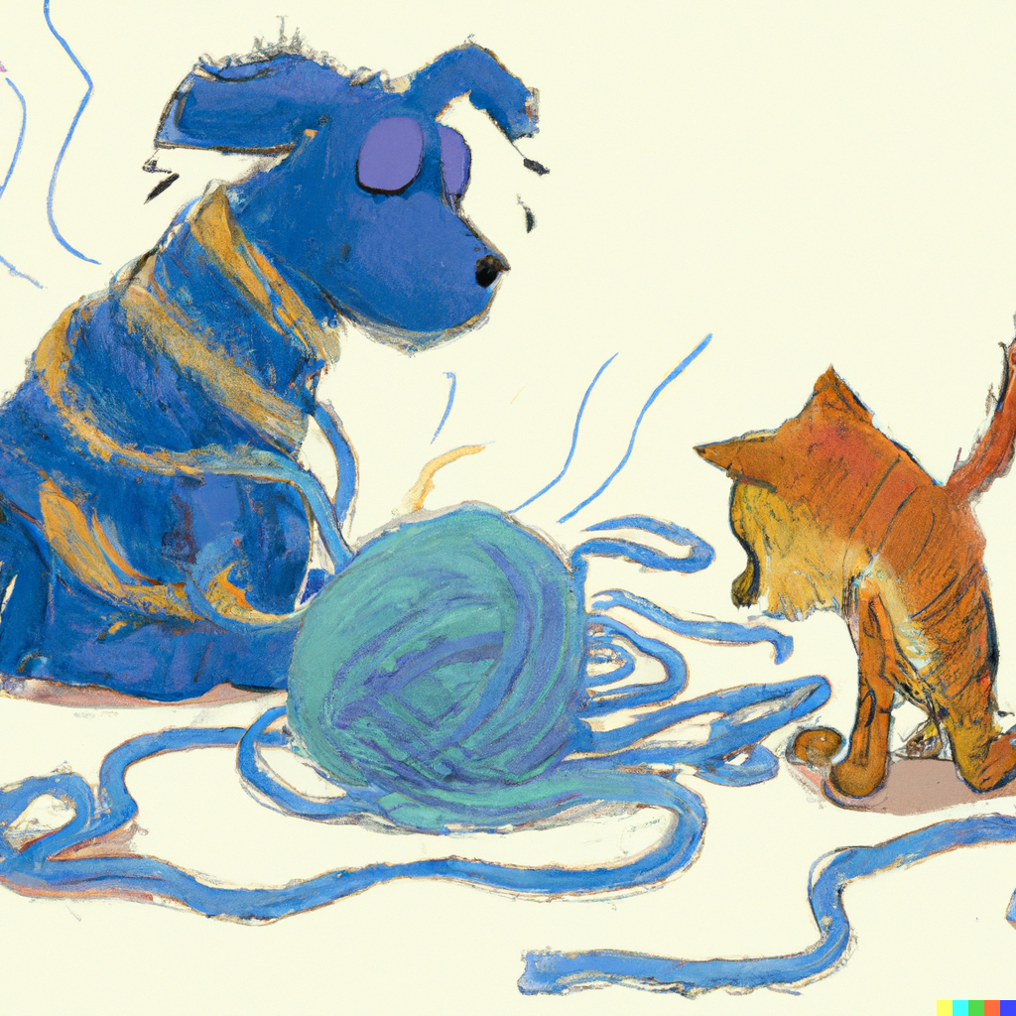
Their paths crossed one day when Benny's wagging tail accidentally knocked over Bella's favorite yarn.

Slide 4
Bella hissed and arched her back, but Benny's floppy ears drooped, and he wagged his tail apologetically.

Slide 5
Benny tried to make amends, bringing Bella a squeaky toy and offering to share his chew bone.

Slide 6
Bella eyed the offerings cautiously, but curiosity got the better of her, and she cautiously batted at the toy.

Slide 7
As Benny and Bella played together, their differences melted away, and they discovered they had more in common than they thought.

Slide 8
Bella realized that Benny's boundless energy was contagious, and Benny learned the art of patience from Bella's graceful moves.

Slide 9
They explored the town together, chasing butterflies, climbing trees, and even splashing in puddles on rainy days.

Slide 10
Benny and Bella became inseparable friends, proving that even the most unlikely pairs can create the most beautiful friendships.

Slide 11
The end.

